Slide 1
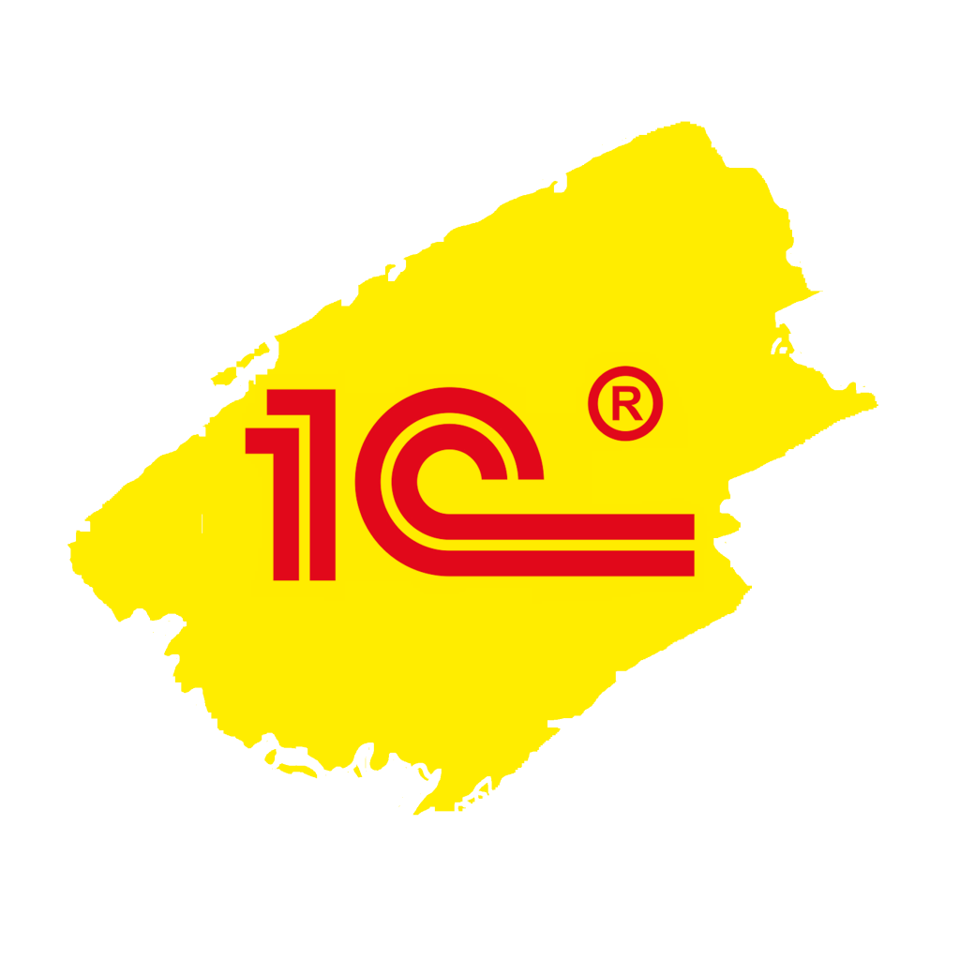
1С:ERP
industries
scales
for different
countries
20 cases
Up to 35 000 + … and more USERS

Slide 2
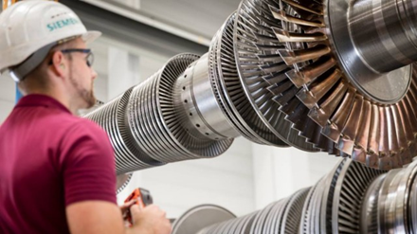
Siemens Gas Turbine Technologies is engaged in the development, assembly, sale and service of gas turbines as well as in the products localization.
industrial and production engineering
300 users
The functionalities of 1C:Enterprise platform is the reason to choose 1C:ERP solution: the platform satisfies high adaptability to the requirements of Russian business, the ability to comprehensively automate all key tasks of the manufacturing plant as well as relatively inexpensive system adaptation to the changes in company's business processes.
Key project results:
Production: settled operational planning functionality, and it is possible now to keep the records of complex custom production (production orders, route lists, dispatching).
Purchasing and inventory planning: the system eliminated deficiencies in the report formation and in the execution of insulation/reservation mechanisms.
Accounting, finances: overall automation of the enterprise’s financial system, including complicated tax accounting (separate VAT), full-featured accounting and accounting in compliance with the international standards (IFRS).

Slide 3
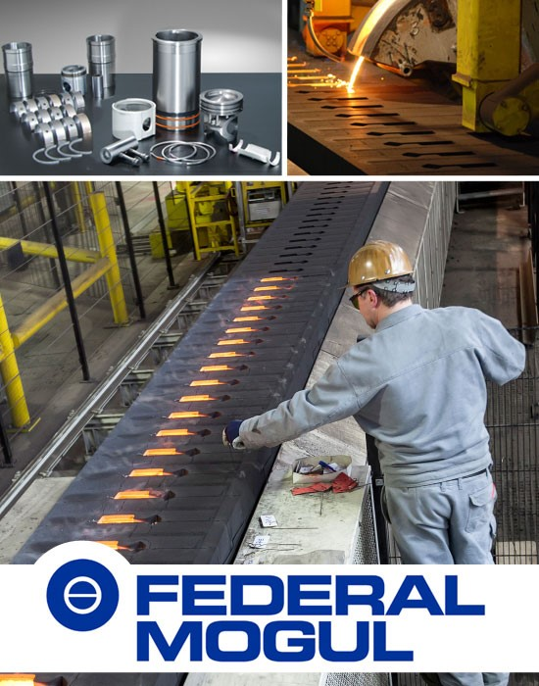
Federal Mogul Corporation is a leading global supplier of technology and components for trucks and cars, which also operates in energy, aerospace, marine, railway, and industrial fields in Russia, Europe, and the United States.
The new system uses 1C:ERP and 1C:Document Management based on 1C:Enterprise to unify the operations across all departments in the division.
full-cycle mechanical engineering
300 users
Key project results:
Planning time is reduced by 50%, as planning had previously been done almost manually.
Now it's possible to plan multi-stage production while taking non-standard cost multipliers into account. Detailed calculation of the cost of all semimanufactures at each stage of production has been implemented. Cost controls have been improved across the entire enterprise.
All documents are registered and stored in electronic form in a single database. As result, information exchange between different departments has been accelerated and simplified. This helps employees coordinate and process the customers' orders and plan procurement, production and sales.

Slide 4
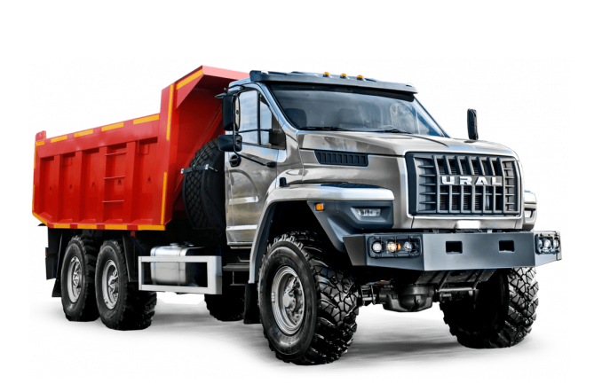
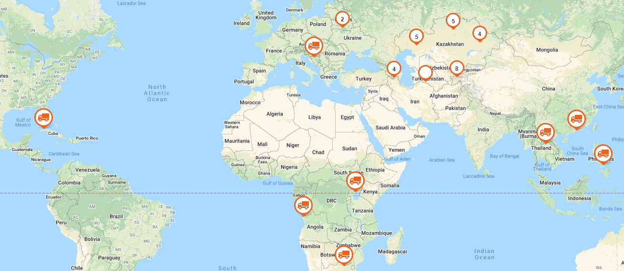
The Automobile Plant URAL dates back to November 30, 1941 when the USSR State Defense Committee ordered to establish new automobile and foundry facilities in Miass based on the evacuated Moscow Automobile Plant named after I.V. Stalin (UralZiS).
automotive
1200 users
Key project results:
The integrated automation project based on 1C:ERP combined the plant management processes in a single digital solution, starting from annual, monthly planning and formation of a bookmark on the conveyor, to the execution of accounting operations and ending with accounting and reporting.
operates in 16 countries

Slide 5
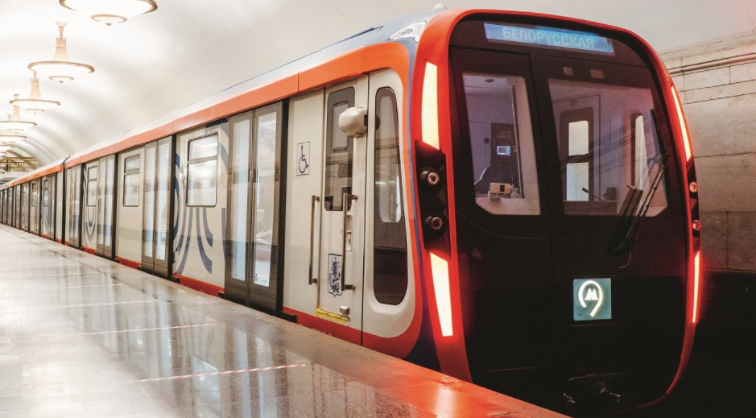
TMH offers a wide selection of products and services, ranging from design and development of rolling stock to turnkey maintenance services and digital traffic control systems. Supply passenger trains and coaches, metro cars, locomotives, engines and components to railway operators and manufacturers in 30 countries
100 000 + employees
full-cycle mechanical engineering
№1
in Russia and CIS
№4
globally
35 000 users
Key project results:
In the management company:
Centralized purchases of inventory items
Maintaining a single nomenclature reference book-classifier
Preparation of consolidated financial statements according to international standards
Accounting and personnel accounting of the management company
At the enterprises of the holding:
Production planning at the inter-shop level and in the workshops
Logistics planning
Cost accounting and cost calculations

Slide 6
Faberlic is the largest Russian company in the cosmetics market, a manufacturer of the unique oxygen cosmetic products. Faberlic’s production is based on European quality standards and is fitted up with the high-tech and eco-friendly equipment, automatic lines for the production, packing and packaging of cosmetic items.
In 2003 the company internationalized its business, nowadays Faberlic has a presence in 24 countries. The firm has up to 30 patents and is included in the rating of Top 100 world's largest cosmetics companies.
cosmetic production
500 users
The implemented information system for production planning and management is developed on the 1C:ERP software product basis. All the fundamental and auxiliary business processes of production planning and accounting were automated as well.
Key project results:
Decreasing the influence of human factor on the implementation of key production management processes;
Reducing time needed for shipment of cosmetics to the end customer due to increased efficiency of business operation registration and enhanced production planning quality;
Ensuring complete traceability of material consumption when manufacturing cosmetic articles (compliance with the GMP standard).
Earlier the Faberlic enterprise used an information system of the ERP type of the foreign supplier to execute production accounting. However, the central ERP system was developed on the basis of the domestic 1C:ERP software product.

Slide 7
Splat Global Ltd is a Russian dynamically growing company, a leading developer and manufacturer of products in such categories as oral hygiene care, home care products and cosmetics, covering up to 18% share of the market. The Splat brand is known in more than 60 countries.
cosmetic production
300 users
Key project results:
Logistics: up to 100 automated workplaces, organized accounting for goods
and materials.
Treasury subsystem: introduced cash & loan management, ensured application
of payment schedule and control over accounts receivable.
Procurement subsystem: considerably improved and implemented functionality for satisfying
the company’s needs. The procurement manager in real time receives information about changes
in the needs of the production department and other divisions.
Production subsystem: the company manufactures more than 10 million units monthly. The production cycle is automated now and all the data is recorded online in the ERP system. This allows monitoring whether the production plan is fulfilled.
Sales and CRM: automated accounting for client orders, order processing and monitoring order status
Repair management subsystem: planning and monitoring of tech maintenance execution, scheduled and spontaneous repairs, manufacturing capacity restrictions.
Automation of a laboratory and quality service in compliance with the GMP requirements: the results of laboratory tests and product and production quality control are stored in electronic form.
Budgeting and consolidation: Introduced processes for collecting information on the actual performance of the company’s divisions and control over budget implementation.

Slide 8
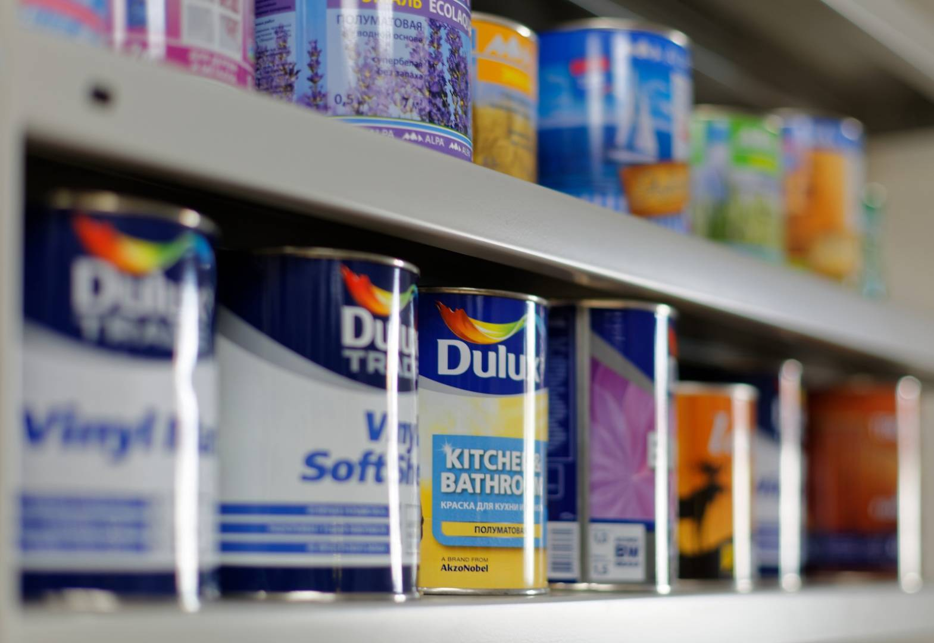
KRONA LLC is one of the top three companies in the Russian market of varnishing and lithography. Up to date it is a modern environmentally friendly complex. It specializes in the provision of varnishing and full-color printing services on tin and aluminum. The complex is equipped with specialized equipment and uses innovative technologies.
chemical production
250 users
Key project results:
Common system for sales, warehouse, and production departments. By this, all employees receive timely information on all changes related to a specific order.
Operational planning of production load. For the developed forms of analysis of production data and stocks, production needs are now quickly determined.
As a result, it minimizes duplicate purchases of materials, their costs have been reduced by 10% and the cost of finished goods decreased by 5%.
Production scheduling optimization. Let track the execution of each order throughout the production route. Dispatchers see all the information about the current state of production (orders in work, orders in the queue, provision of orders with materials and components, percentage of completion of the primary production stages and final assembly) on one page.
An accurate inventory of products in stock. Previously, the number of unaccounted products reached 10% of the total inventory.
The company is constantly improving its technological production base and increases production volumes. With business growth, increases the number of new and regular customers and also grows the monthly number of orders.

Slide 9
The Bonolit Group is the largest Russian company incorporating leading autoclaved aerated concrete plants and the extraction and processing of non-metallic materials enterprises in the Central and Volga Federal Districts. The company's aerated concrete market share exceeds 20%, the total production volume has reached 1 million m³ per year.
production of building materials
250 users
Key project results:
A mechanism has been developed for integration with the production line, accounting of output and semi-finished products using resource specifications which have been automated. This allowed establishing continuous monitoring of product quality, consumption of raw materials and materials, including semi-finished products (per unit of output). There is an opportunity to receive operational data on production costs in the required details.
Sales management has been optimized by automating key business processes covering the work of the central and related structural divisions: production department, warehouse complex, sales department, marketing and accounting departments.
Using the new system, managers receive orders from customers and select the optimal shipment terms and delivery conditions, taking into account the current balances of finished products in warehouses and the volume of products produced that can be shipped to customers in the near future.
Opportunities for uninterrupted shipment of finished products and their delivery by road have been provided.
The management of the group decided to set up a modern information system, the typical functionality of which would enable building the main business processes in a single format at all Bonolit Group enterprises.

Slide 10
Bang & Bonsomer Group is a group of companies engaged in the implementation of smart technologies and materials, including the field of accounting automation. Smart material technologies are a combination of distribution, own products, smart process technology solutions, services and own application laboratories/technical centers. Bang & Bonsomer operates
in 9 different countries.
new materials engineering
300 users
Upon completion of testing various solutions, Bang & Bonsomer made a choice in favor of the modern 1C:ERP software, developed on the 1C:Enterprise platform since the execution of business processes in almost all scenarios didn’t require any improvements
Key project results:
Such improved business processes as the system of control and execution of payments, moving procedure between the warehouses, goods acceptance and shipment, sampling management, dangerous products transportation control, etc.;
Arranged accounting in compliance with the IFRS and the corporate standards;
Significantly increased overall efficiency of employees performance;
Enhanced discipline of co-worker interaction and optimized functioning of different departments and services.
To reduce the labor costs of users, the following robotization elements were introduced: a workplace for a logistics manager, automatic loading of state customs declarations, automatic document creation when moving and shipping the goods, automatic control of storage and transportation of dangerous products and lots of others.

Slide 11
production of consumer goods
Era Group is one of the world’s leaders in the production of modern ventilation systems. This company operates the full production cycle: from designing new products to delivering them to the end-customer. The company supplies the ventilation systems to 24 countries, including Russia, Egypt, China, Mongolia, Great Britain, Belgium, Poland and others.
250 users
To transform the existing functionality to a new platform in order to improve the stability and reliability of the system and utilize new platform’s features. Subsequently, the company is going to increase the number of tasks solved by employees in the new system
Key project results:
Ensured transparency of the treasury process and financial management;
Automated planning of sales and procurement, a simplified scheme for working with goods;
Simplified schemes of interaction with the WMS system in respect of shipment, delivery, and acceptance of products.
Remote project fulfillment: using Skype and Itilium services for discussion, remote training, solving different issues and user support.

Slide 12
Kartli group of companies is one of the leading traders of polymer products in Russia and other countries. Everyday the company ships more than 200 trucks with polyethylene, polypropylene, polycarbonate, polystyrene and ABS plastics.
Nowadays, the company’s branches are registered in Switzerland, Belarus, Kazakhstan, and Turkey. Kartli actively cooperates with the largest manufacturers of polymer raw materials and thousands of producers of final products.
distribution
200 users
The implemented 1C:ERP software has become the fundamental holding management system and is a central element in the interaction of key information systems of the company.
Key project results:
The new system unified the work of Russian and foreign divisions of the holding while maintaining accounting features in different countries. The management got the opportunity to control the work of branches and representative offices anywhere in the world using the mobile version of the system. Employees’ executive discipline increased.
Improved procurement and sales planning.
Organized operational accounting of goods at warehouses. An interested user (procurement or sales manager, for example) at any time can get up-to-date information on current stock balances. Implemented feature to remotely control the movement of goods in warehouses using the mobile application.
Optimized order delivery to customers. The system is integrated with transport Internet services. It’s possible to connect to the service directly from 1C: ERP, select vehicles, arrange and monitor the transportation.
Accelerated generation and approval of agreements, specifications and other documents.
Sales volume increased by 35%, the company's profit grew by 25%.

Slide 13
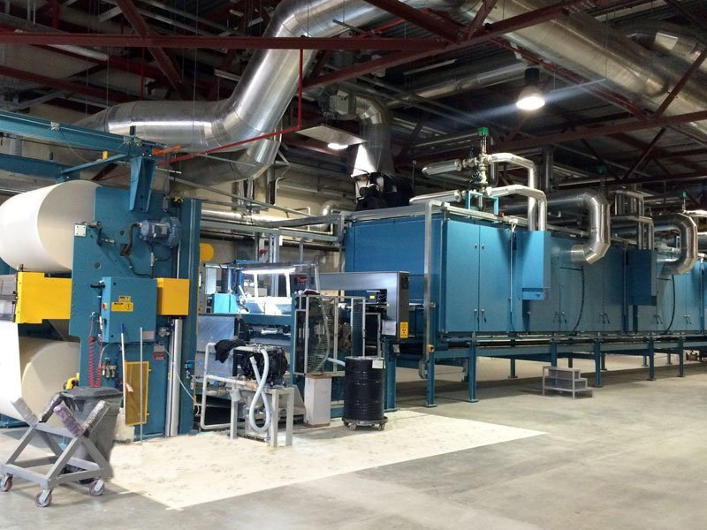
FIPAR is a Russian wallpaper factory, part of the ZAMBAITI PARATI group of companies (Italy). It specializes in the premium class wallpapers production based on Italian technology. The factory is equipped with the latest technology.
production of consumer goods
250 users
Key project results:
Warehouse and logistics: automatic construction of all necessary reports on the movement and accounting of goods and materials: types, collections, etc.; warehouse stocks management; reservation of goods and materials; inventory of goods and materials in workshop pantries.
Sales: placing customer orders, pricing, price lists, sales inventory of goods and materials, the formation of a schedule for receipt of payments, settlements with customers, wholesale, commission trading, functionality to build all the necessary sales reports for managers, customers, all types of products and a wide selection of additional details.
Purchasing (supply) and managing supplier relationships: accounting for the receipt of raw materials and materials, managing supplier relationships, settlements with suppliers.
Production: production costs accounting, calculations of actual cost, fixed assets accounting, calculations of depreciation, accounting for production services, workwear and special equipment, management of product data, recipe.
Management and accounting: accounting, tax accounting, including regulated reporting.
10%
inventory
material costs
operating expenses
reduction in

Slide 14
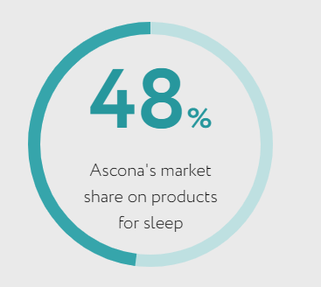
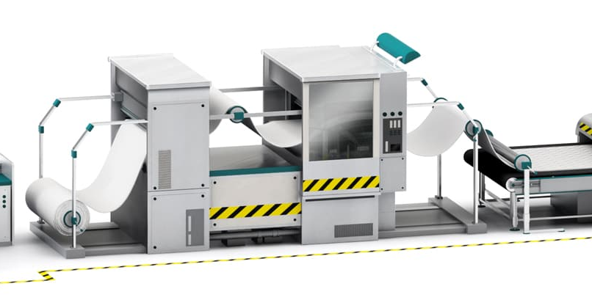
All Ascona mattresses are manufactured on a unique automated conveyor line. Component materials are purchased from leading domestic and foreign manufacturers. Ascona is the holder of many patents for spring blocks and materials, as well as licenses for the production of leading world brands. The factory has the highest productive capacity in Eastern Europe.
production of consumer goods
1 200 users
Askona products are appreciated by millions of Russians, mattresses are approved by the specialists of Ministry of Health of Russian Federation. Today Askona mattresses don’t have any analogues in Russia.
Key project results:
Daily…
The project of complex automation on 1C:ERP from annual planning to the execution of operations in production, ending with accounting.
10 production sites have been automated, covering the full end-to-end technological cycle of production.

Slide 15
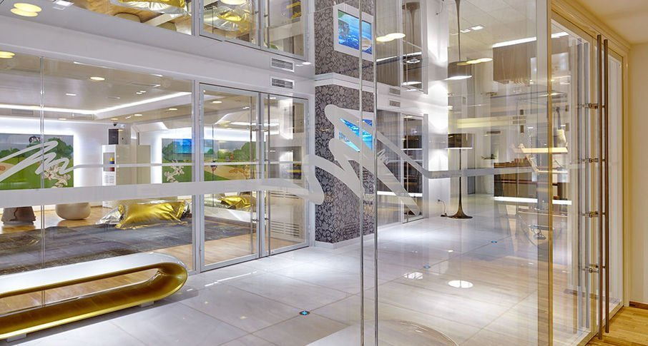
GlassTechnology LLC is a glass processing company. It specializes in production of various types of glass of high quality: from usual single-layer version to complex solutions with individual design. Everyday the company receives about 200 orders for production. Upon receipt of each order, it is necessary to quickly evaluate the possibility of its execution within the period desired by the client, form a specification, and calculate raw materials.
production by order
200 users
Key project results:
All of the enterprise's critical tasks (production, procurement, processing, product release, individual customer orders, sales, etc.) are now regulated and automated.
Data collection terminals (TSD) are connected to the system, which is used to register the beginning and completion of production operations, accounting of materials and marriage at each stage of the technological process.
Real-time information about each stage of the orders production execution is now available. Sales managers no longer need to contact the employees of the planning and dispatching department and employees of production units to obtain information about orders readiness.
Accurate calculations of the actual production costs that has been provided. It helps to control the cost of production and rationally manage the profitability of orders.
The company needed an information system that would standardize procurement, warehouse, and sales management, organize operational production planning for customer orders.

Slide 16
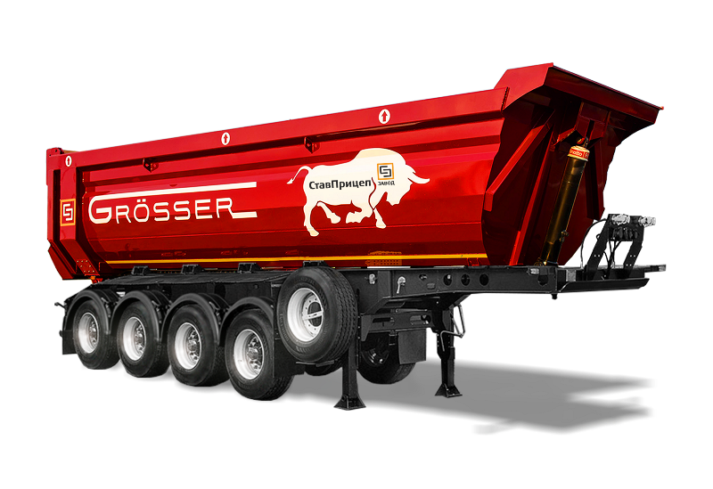
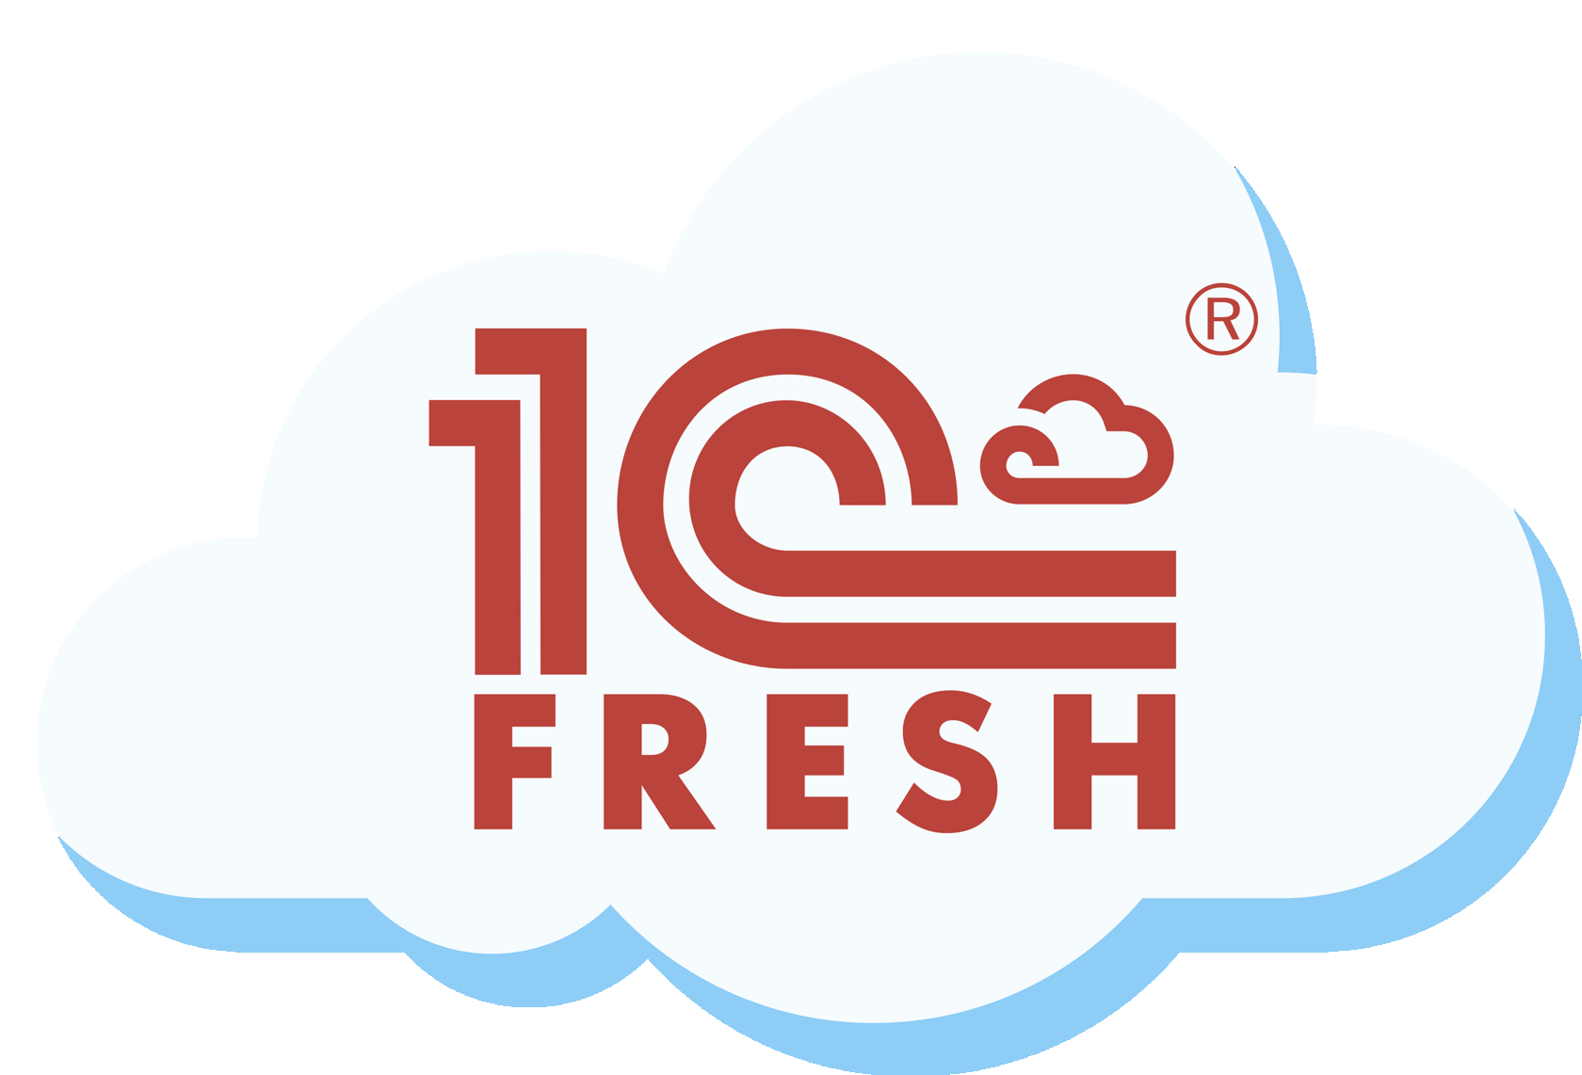
StavPrizep Group specializes in the manufacturing of cargo bodies for vehicles, trailers and semi-trailers.
mechanical engineering
50 users
The implemented information system is developed on the 1C:ERP solution basis and is hosted in the 1C:Fresh cloud service which enables the employees to work from their local computers, using the web client, without using the server.
Key project results:
Train employees to work in the 1C:ERP system using cloud service;
Ensure accounting for production operations;
Ensure cost calculation and production report generation;
Develop and implement “order processor” using extension technology in the 1C:Fresh cloud service following specific peculiarities of the vehicle sales department accounting;
Implement bookkeeping and commercial accounting;

Slide 17
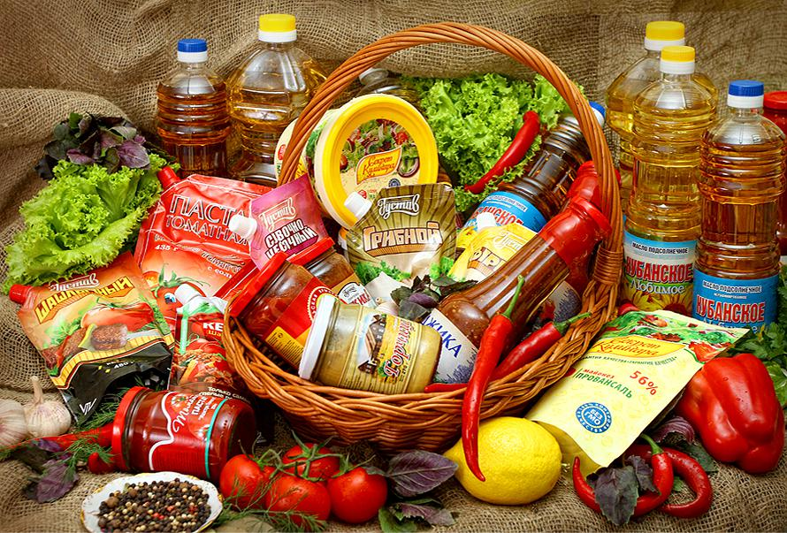
Agricultural Production Enterprise Yug LLC (APE “Yug”) produces red and white sauces, vegetable oil under several well-known brands: “Family Secrets”, “Kuban Favorite”, “Culinary Secret”.
agricultural industry
500 users
Key project results:
The system helped to improve production planning considerably. The company can correctly assess the reserves of production capacities and optimize its load.
The number of line readjustments and the marriage associated with these readjustments have been reduced. Production volumes increased by 20%.
The system promptly generates orders for maintenance of production equipment.
The accuracy of calculating production costs has improved. The management has tools to control the costs of producing each type of product, analyze the cost structure and take measures to reduce them.
The procurement department now always has up-to-date information on stock balances and current production orders. This information helps to plan orders for suppliers and reserve storage space for ordered goods.
Managers have up-to-date data on stock balances, which allows them to reserve products in the warehouse in real-time and form orders for shipment.
Regulated reporting is generated automatically, and using the 1C:Reporting service is timely submitted to regulatory authorities.
An information system that would allow combining the work of departments, speed up the processing of incoming orders and improve production planning

Slide 18
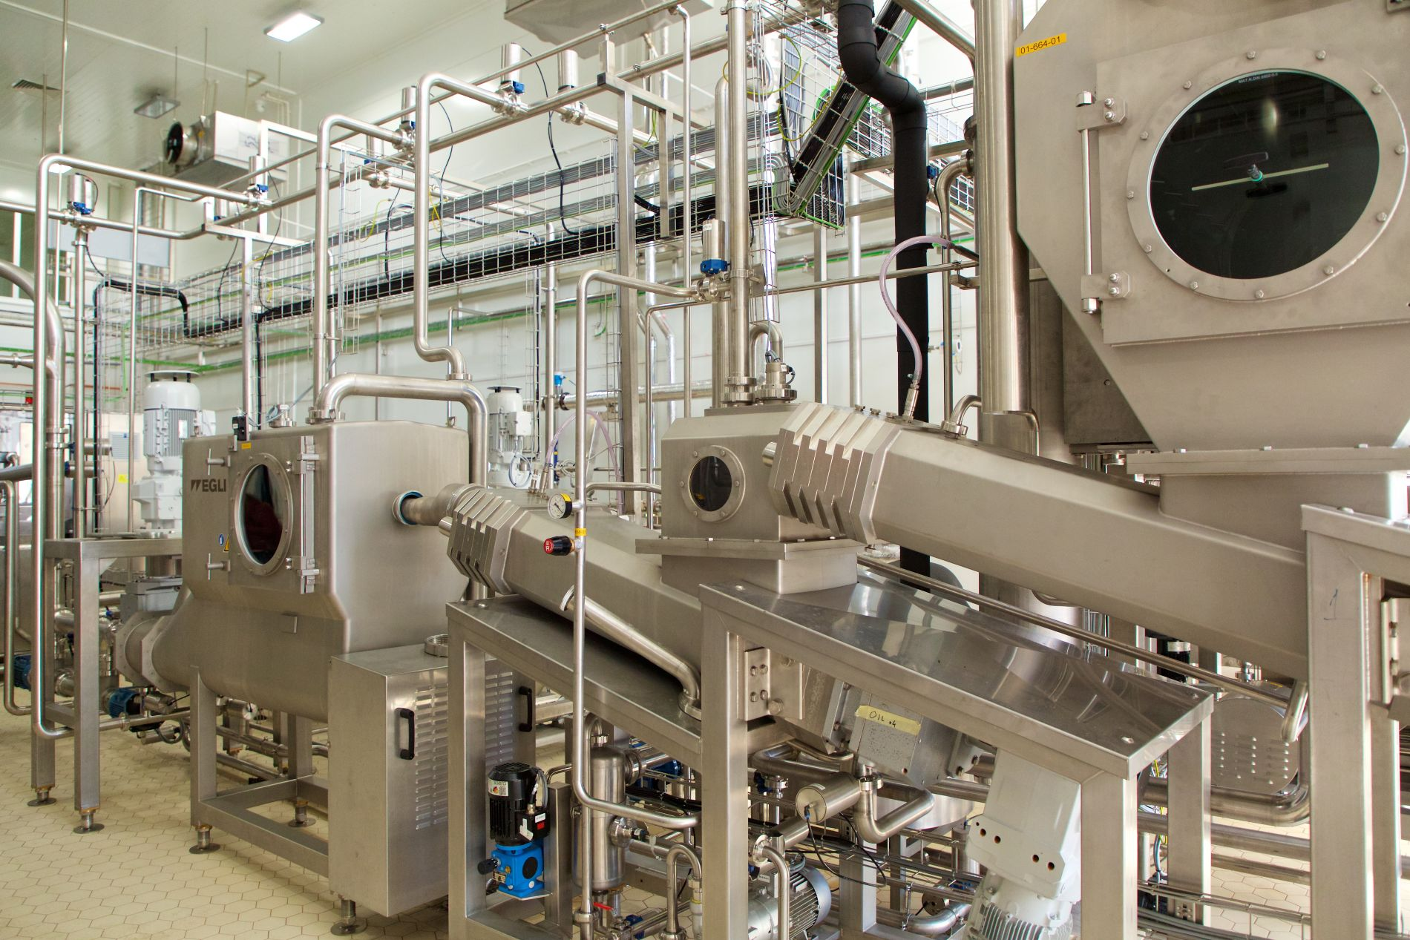
Agrocomplex company n.a. N.I. Tkachev is one of the largest agro-industrial holdings in Russia. The company is engaged in crop production, compound feed production, animal breeding, poultry farming and meat processing. The technological cycle covers all stages of production and sales: from the field to the counter. Products and raw materials are stored at 9 logistic distribution centers. Its retail chain has 700 brand stores. The company employs about 40 thousand employees.
agricultural industry
20 000 users
Key project results:
Created unified services of procurement, treasury, warehouse and logistics management.
Centralized investment, loan and collateral management; unified forms of enterprise budgets and financial planning regulations; standardized operational consolidation of corporate reporting (CPM).
Implemented unified system of electronic document flow (Document Management).
Created centralized system of the holding’s retail shops management (Trade Management).
Organized standardized personnel accounting, payroll calculation (Payroll and HR Management).
Implemented detailed cost accounting in crop production, gardening and animal breeding taking into consideration the peculiarity of cost calculation in agriculture (Accounting at Agricultural Enterprise)
The geographical distribution of automated workplaces and information bases. It is also the specificity of a wide range of industry specific tasks.

Slide 19
HRS Company is an international company with a leading position in the field of software solutions for the HoReCa industry and retail enterprises. They carry out pre-project research, the provision of consulting services for the optimization of business processes, the implementation of turnkey systems, including personnel consultations, the supply of software and hardware
software development
500 users
Key project results:
Unified information system for operational, managerial and financial accounting. The ERP system has been implemented with simultaneous operation for more than 45 foreign legal entities.
The subsystem of mutual settlements with customers with the ability to drill down by customer orders, invoices for payment and settlement documents.
Universal layouts with the ability to print data and field headers in a selected foreign language.
A project management subsystem with the ability to plan human resources for project tasks.

Slide 20
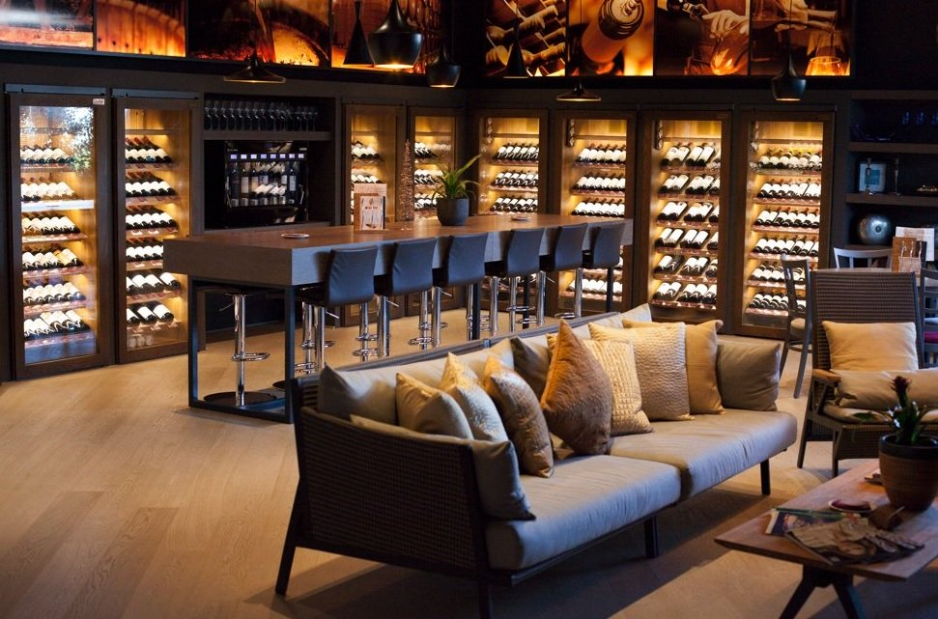
D-Wine company does business in the south of Spain, successfully combining the format of boutique restaurants and lounge wine stores, which represent several thousand items of the best producers in Spain, Italy, France, Argentina, Australia, New Zealand, and the USA. The company's business is developing dynamically, the range of products, and the geography of the business is expanding.
trading
50 users
D-Wine needed a functional and highly flexible system that would support organizational know-how and grow as the business grew. Local Spanish developments were considered while choosing the product, but their functionality was limited and did not cover the requirements of the D-Wine business. When analyzing the ERP systems of European manufacturers, it turned out that it would be difficult and time-consuming to adapt them to the specifics of the company's business processes. Therefore, they decided to take into consideration 1C:ERP
Key project results:
Reduce the costs of the services provided by 15%
Cut administrative costs by 50%
Increase the turnover in warehouses by 15%.
Within the financial block, intra-group operations, management reporting and basic regulated reporting were automated in accordance with the legislation of Spain and the European Union.
During the project, the main operational processes were automated: provision of services, sales, purchases, prescription production. Special emphasis were placed on accounting for material, labor, and administrative costs.

Slide 21
MCS Coca-Cola is a part of the MCS Group Holding, which specializes in the field of information, communications, construction, real estate, industry, and infrastructure. It implements large-scale projects aimed at the global development of Mongolia. MCS Coca-Cola has been producing world-class drinks since 2002. Today it produces 140 types of products of 9 brands.
food production
200 users
Key project results:
A common information space for the all departments in the online mode, which removes the double reflection of the same operations, redistributes the responsibilities of employees and uses the human resource by about 20% more efficiently.
Organized address storage of products. The system reflects all the necessary information about the product. As a result, the increased company expects — 15% reduction in the loss of goods from spoilage and marriage.
Up-to-date information on stock balances and current production orders, which allows the company to improve quality of planning and make management decisions more quickly.
Accuracy of the cost budget calculations has increased due to a more detailed distribution of indirect costs for the output product.
Monitoring of employees’ performance improvement. The expected increase in labor productivity is 30%.

Slide 22
1С:ERP
for different
Thanks for your attention!

